Slide 1
Progress Week 2
Restaurant Dairy
Dave DaCosta, Jake Adamson,
Rob Cucchiara ,Nathan Ko

Slide 2
Overview
For this week we worked on having a functioning database.
We have two database tables.
We are also able to fetch restaurants from Yelp.
We have a relatively functioning app.

Slide 3
Teamwork
The individual features are mostly implemented, so that we can focus on tweaking the bugs and the user interface from this point.
We feel that we have the skeletal structure of the code done which closely resembles what we have in mind for our final application.

Slide 4
Individual Contributions
Dave: I established Yelp API querying to the point where we grab 90% of the information we need.
Jake: Finished the VisitedCursoryAdapter, stubs of WantToVistCursoryAdapter, Restaurant class, and RestaurantAdapter classes.
Nathan: Implemented an additional database table using the same in app URI for easy data access,
Rob: Created the Form activities and layouts, fixed a small bug that caused the app to crash when clicking on a certain a button, and made minor ui changes

Slide 5
To Do
improve our current GUI
The search API currently works on a single phone but we need to resolve any authentication issues.
We also need the ability for the user to edit a single list item.
We also need the ability to delete individual list items.
It would also be nice to be able to move a list item in the Prospective Restaurant list to the Visited Restaurant list but it is not a top priority.

Slide 6
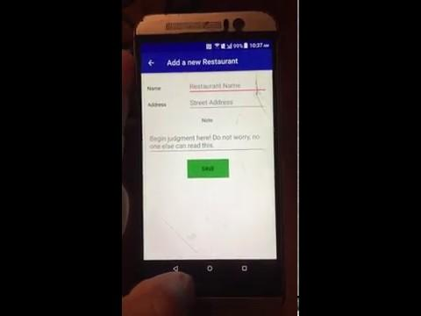
Demo
Demo Video

Slide 7
Challenges
Some of are team is have a hard time understanding git workflow
Authentication of Yelp api
Machine learning

